Slide 1
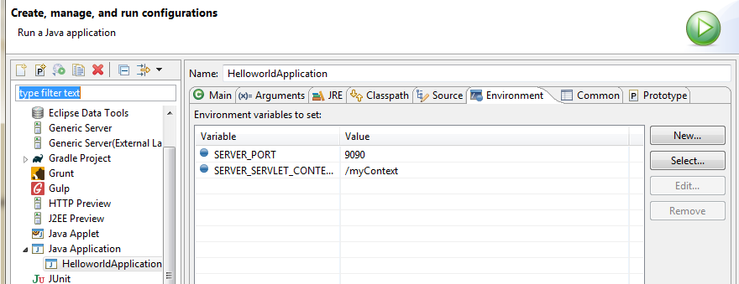
Spring Boot – How to Change Default Context Path and port using Eclipse Run Configurations?
Click on the Environment tab and configure context path and server port as follows
SERVER_SERVLET_CONTEXT_PATH = /myContext
SERVER_PORT = 9090

